Slide 1
Smart laundry room
Group 5
111062572 施冠彰
111062644 黃廉傑
111062510 張又仁
111062575 許詠晴

Slide 2
Outline
Introduction
Motivation and application
System and structure
Software and algorithm
Hardware
Application Scenario
Market analysis
Reference
Task partition

Slide 3
Outline
Introduction
Motivation and application
System and structure
Software and algorithm
Hardware
Application Scenario
Market analysis
Reference
Task partition

Slide 4
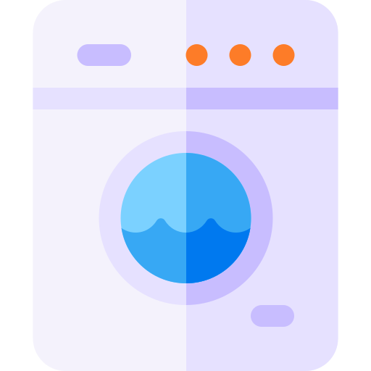




Motivation and Application
How much time do you spend on do the Laundry?
Ideal Laundry Time
0Hr 0Min
0Hr 50Min
13Hr 50Min
14Hr 0Min
Take the blanket
To the washing machine
Complete washing
Dry clothes
Complete dry clothes
Folding clothes
Complete
Do laundry

Slide 5


Motivation and Application
How much time do you spend on do the Laundry?
Actual Laundry Time
……
0Hr 0Min
0Hr 10Min
1Hr 10Min
2Hr 0Min
5Hr 0Min
5Hr 10Min
Take clothes to
Washing machine
No available machine, waiting
Found available machine, start laundry
Hang the clothes, wait for dry.
It's raining!
Change to use clothes dryer
No dryer available now.
Waiting…

Slide 6


Motivation and Application
We Spent too much time to do the laundry
Wait for available watching machine → 25Min ~ 50Min
Bad weather cause the clothes hard to dry, even redo the laundry → 12Hr ~ 24Hr
Wait for available clothes dryer → 30Min ~ 2Hr
No complete notification, task done but not yet to get your clothes → 1Hr ~ 24Hr
Average waste time: 8 Hr per once (Worst Case)
Do laundry twice per week → 64 Hr/month, 768 Hr/year
Take the lecture with 3 academic credit in 1 semester
→ 60 Hr, you can take additional 12 lectures in one year
Take 20 Hr you can learn one skill
→ You can learn additional 38.4 skills in one year

Slide 7

Motivation and Application
Wrong Washing & Drying Cause Clothing Damage
Different clothes material need different washing process
Different clothes material need different Drying time, temperature
Most People do not know it. Cause Clothing Damage

Slide 8
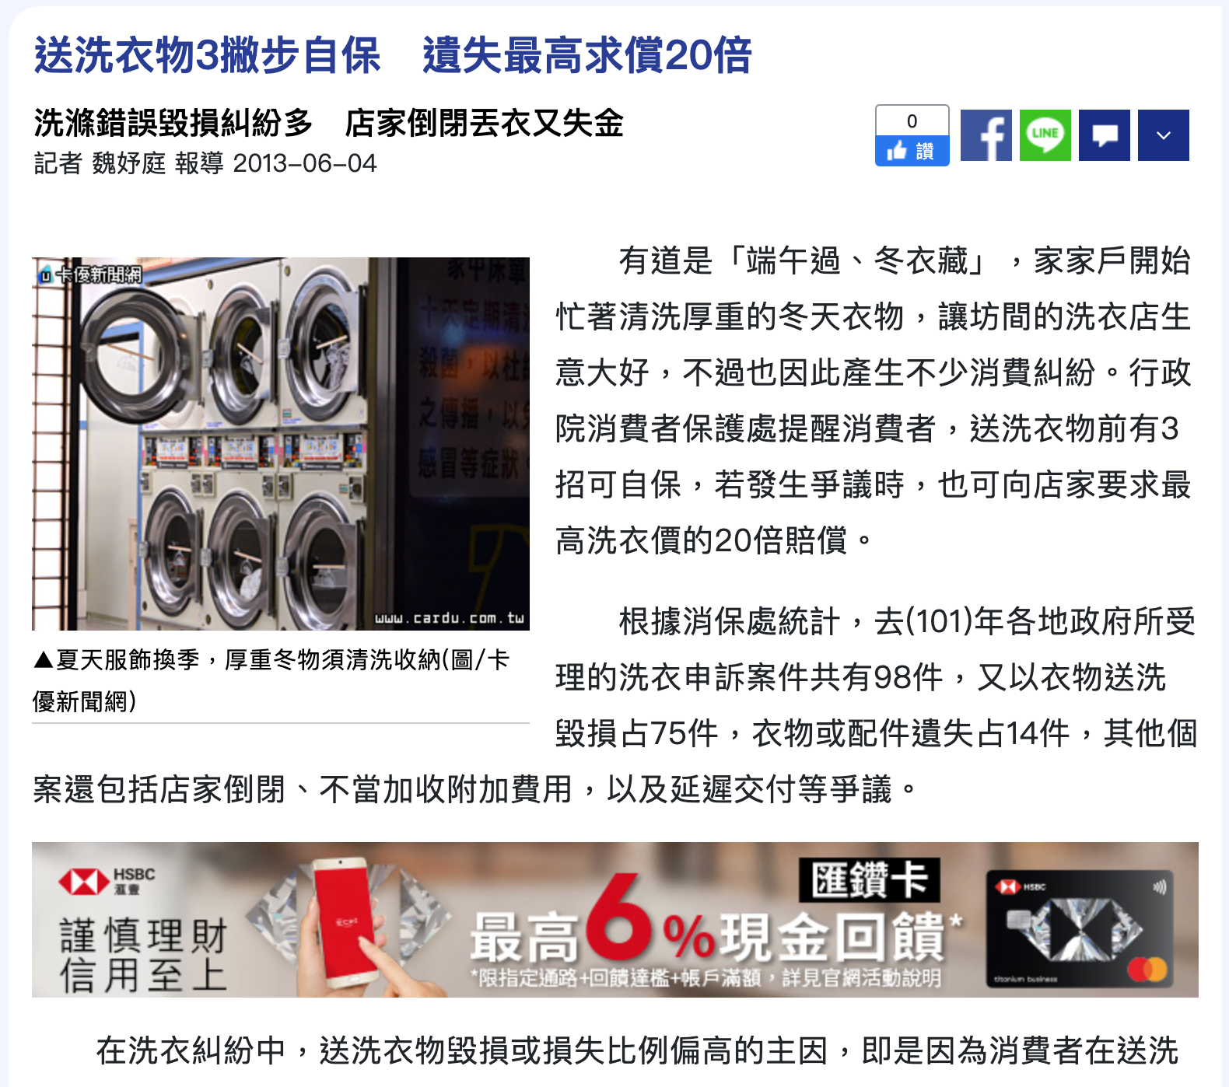
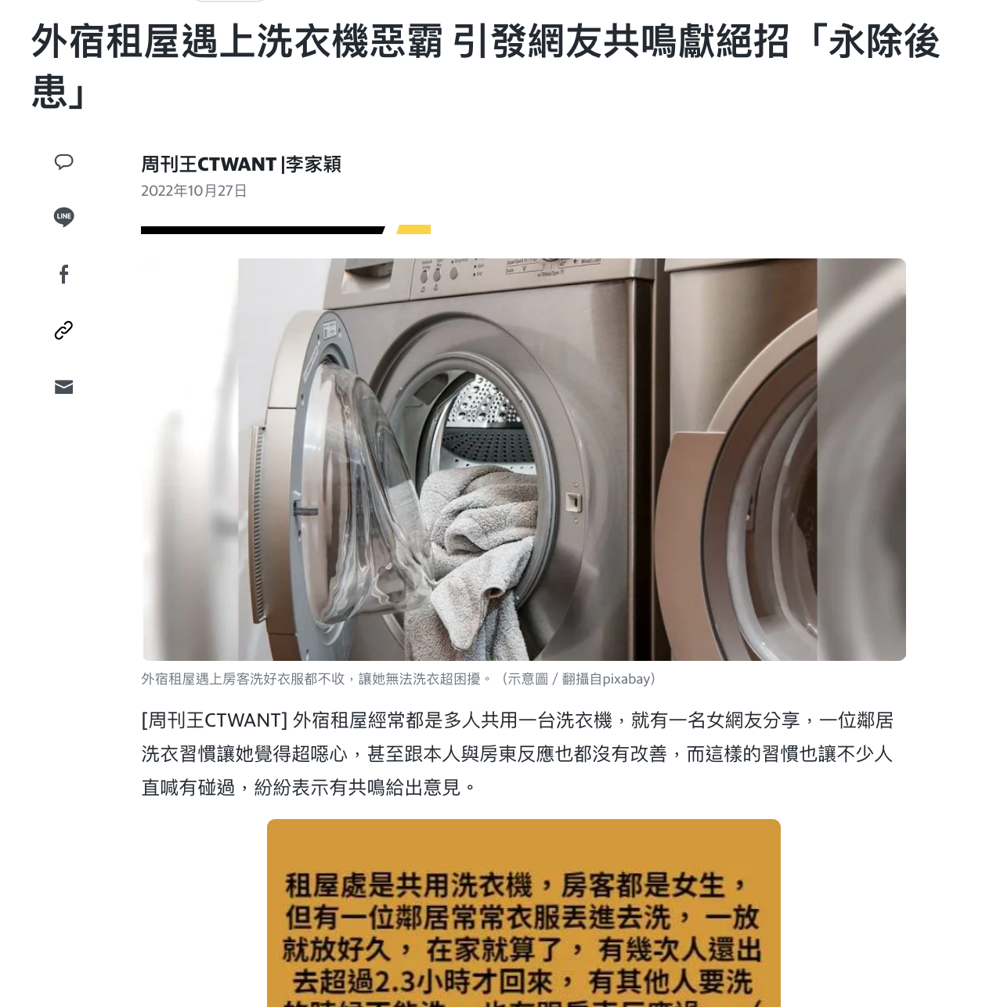
Motivation and Application

Slide 9





Motivation and Application
Laundry Cloud Admin
Laundry Cloud APP
Laundry Cloud
Smart Washer
Smart Dryer
Smart basket
Smart hanger

Slide 10
Outline
Introduction
Motivation and application
System and structure
Software and algorithm
Hardware
Application Scenario
Market analysis
Reference
Task partition

Slide 11
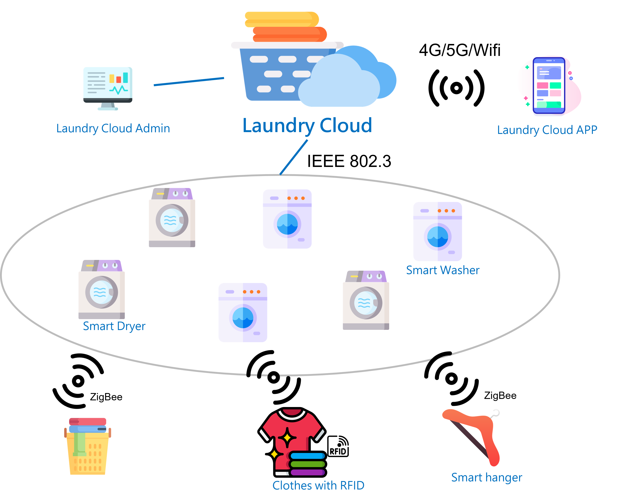
System and structure
Smart basket

Slide 12


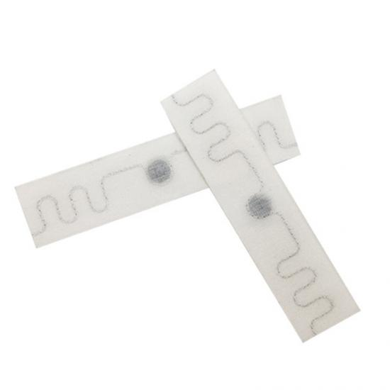
System and structure Hardware
Clothes with UHF RFID Laundry Tag
Identify different clothes material
Recommend washing process
Recommend washing Drying time, temperature
RW700 RF
Frequency: 860~960MHz
Protocol : EPC Class1 Gen2, ISO18000-6C
Reading distance : 6m
Chip :NXP UCODE 9
Size :90x20mm
Packing material :
Washing: 90℃(194οF), 15 minutes, 200 cycles
Pre-drying in Tumbler: 180℃(320οF), 30minutes
Ironer: 180℃(356οF), 10 seconds, 200 cycles

Slide 13
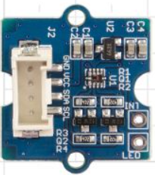

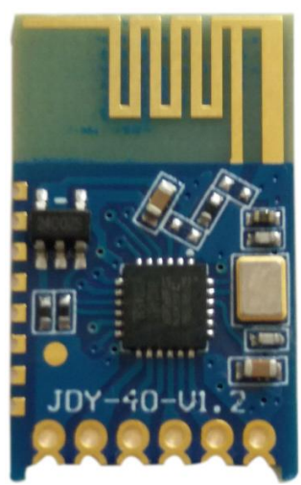
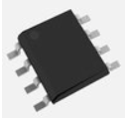
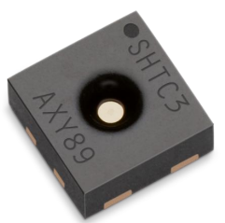
System and structure Hardware
Programmable configuration
3.3/5V Supply
Detect sunlight directly
Grove compatible
I2C Interface
Smart hanger
With humidity sensor
Using Zigbee to transfer hunidity data
Grove – Sunlight Sensor
Smart cloth rail
With Sunlight sensor
wireless charging function
Humidity sensor-
SHTC3-TR-2.5KS
Microprocessor-
pic12f675
Zigbee transmitter
JDY-40
8-bit I2C address
MCU 8-bit PIC RISC 1.75KB Flash 2.5V/3.3V/5V Automotive
8-Pin SOIC N Tube RoHS : Compliant
2.4G technology
with a distance of 120 meters

Slide 14

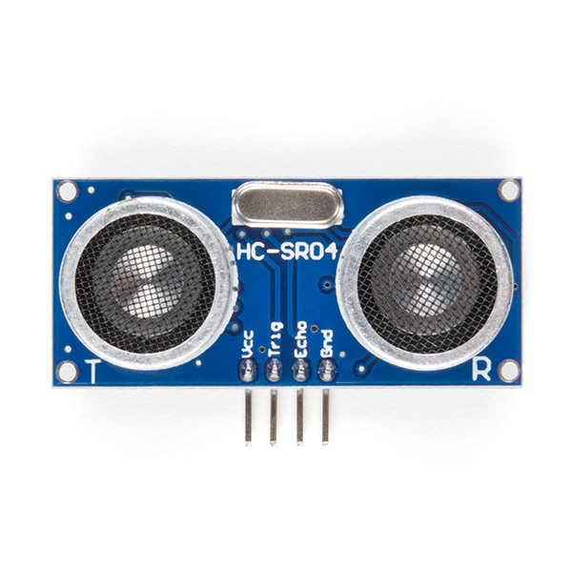
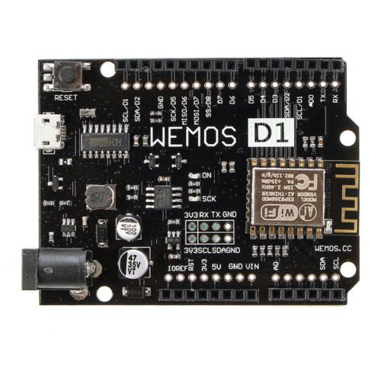

System and structure Hardware
Smart basket:
Check the amount of clothes
Remind users to do laundry
Wireless charging function
WiFi
Laundry Cloud
Ultrasonic Distance Sensor - HC-SR04
5V Supply
Trigger Pulse Input :10uS TTL pulse
Echo Pulse Output
0V Ground
WEMOS D1 R2 V2.1
Microcontroller: ESP8266EX
Analog Input Pins: 1
Digital I/O Pins: 11
Flash Memory: 4MB

Slide 15
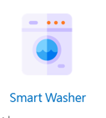

System and structure Hardware
Smart Washer and Smart Dryer function similarly.
Reserve system (app), if the device is reserved, the washer/Dryer will be locked.
Identify clothing RFID and take suitable washing/drying method.
Being a coordinator between smart hanger/ clothing and laundry cloud.

Slide 16
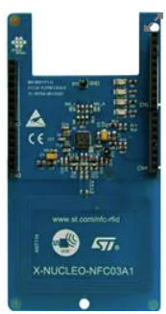
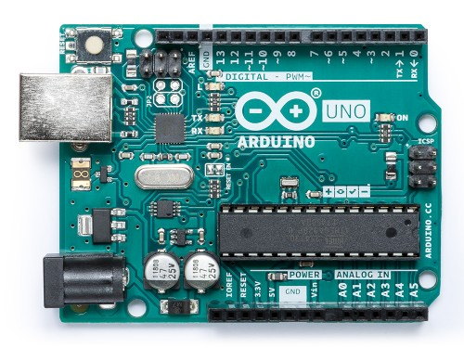
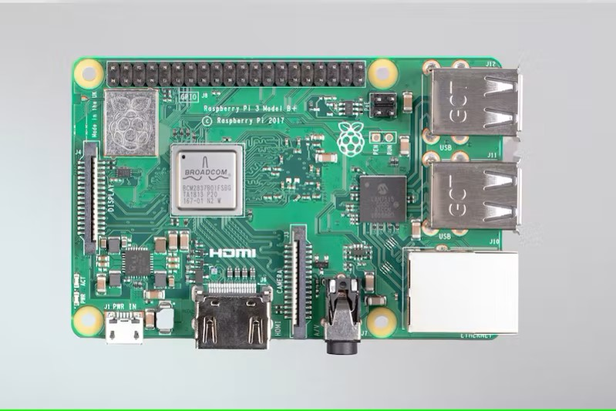
System and structure Hardware
RFID Reader-
NUCLEO-NFC03A1
RFID Expansion Boards
Core: CR95HF-VMD5T
RFID Reader/Transponder
Smart washer/dryer
IEEE 802.3 ethernet
Laundry Cloud
processor-
Raspberry Pi 3 Model B+
Spec. is in the following slide
Microcontroller-
Arduino Uno R3
microcontroller board based on the ATmega328P
6 analog inputs
14 digital input/output pins
USB connection

Slide 17
System and structure Hardware
Raspberry Pi 3 Model B+
Broadcom BCM2837B0, Cortex-A53 (ARMv8) 64-bit SoC @ 1.4GHz
1GB LPDDR2 SDRAM
2.4GHz and 5GHz IEEE 802.11.b/g/n/ac wireless LAN, Bluetooth 4.2, BLE
Gigabit Ethernet over USB 2.0 (maximum throughput 300 Mbps)
Extended 40-pin GPIO header
Full-size HDMI
4 USB 2.0 ports
CSI camera port for connecting a Raspberry Pi camera
DSI display port for connecting a Raspberry Pi touchscreen display
4-pole stereo output and composite video port
Micro SD port for loading your operating system and storing data
5V/2.5A DC power input
Power-over-Ethernet (PoE) support (requires separate PoE HAT)

Slide 18
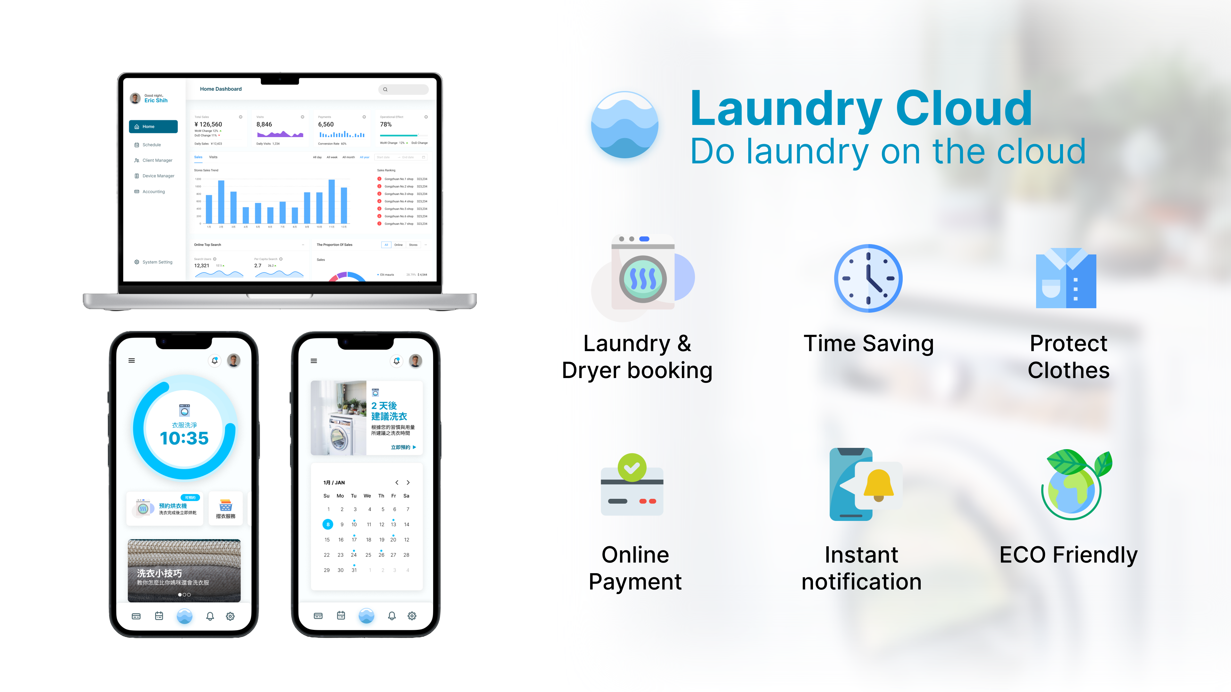
System and structure Software

Slide 19
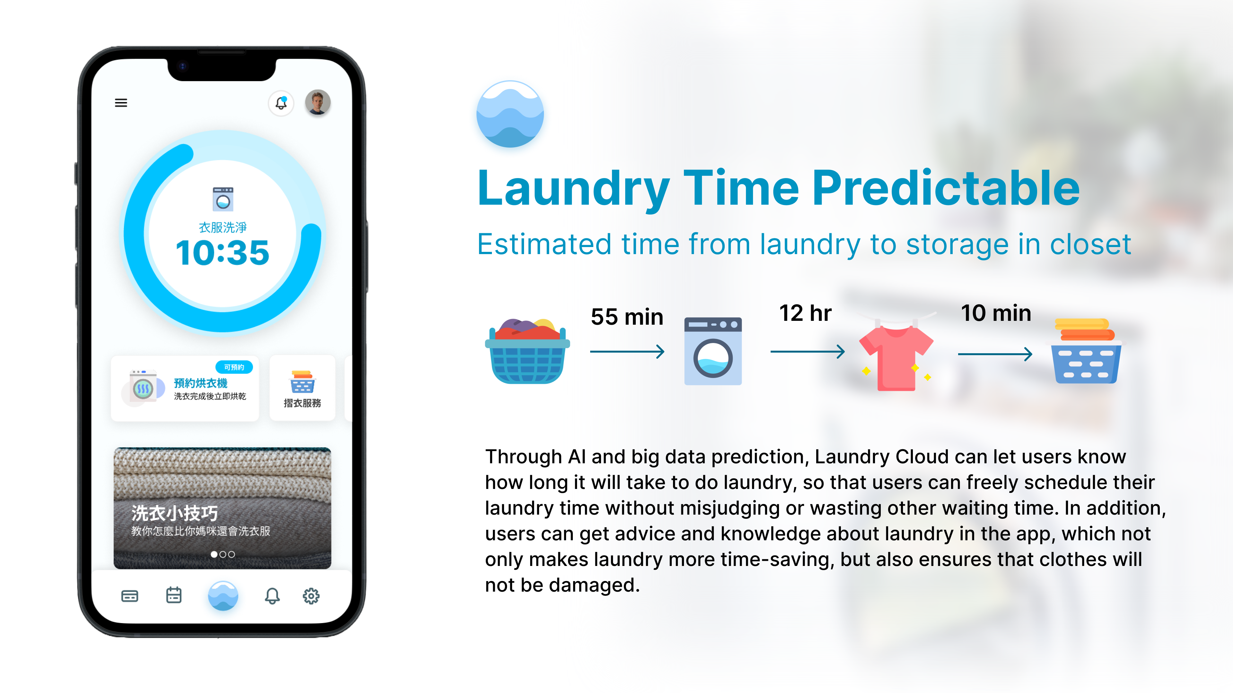
System and structure Software

Slide 20
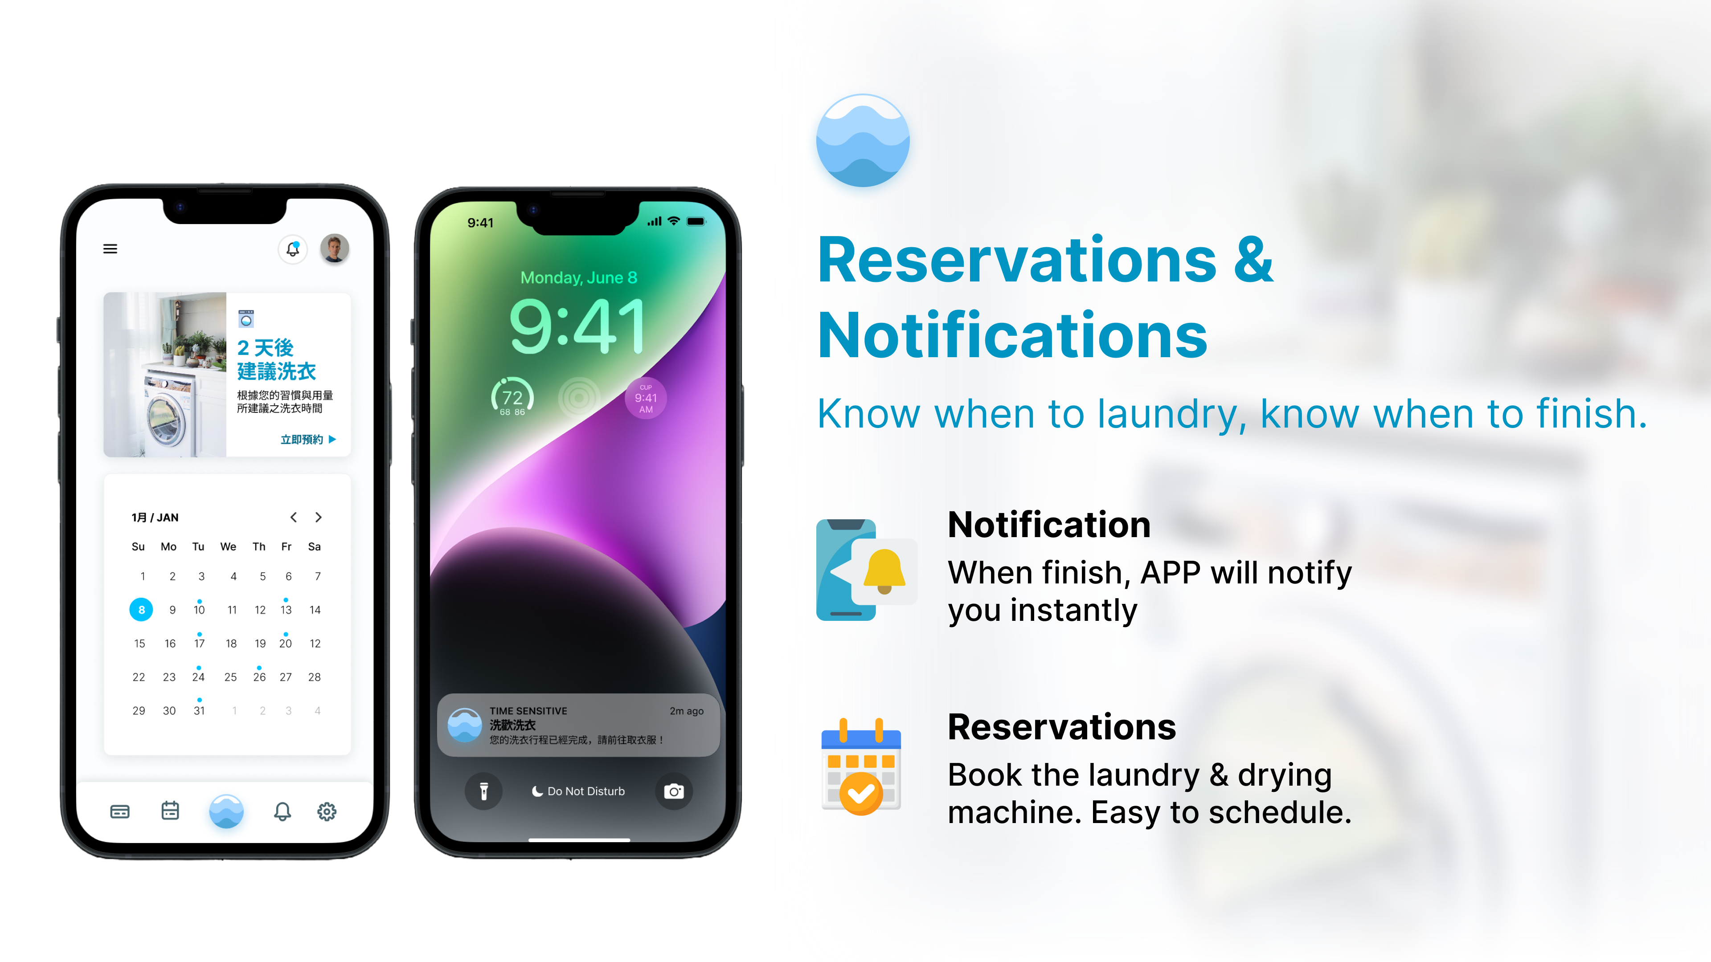
System and structure Software

Slide 21
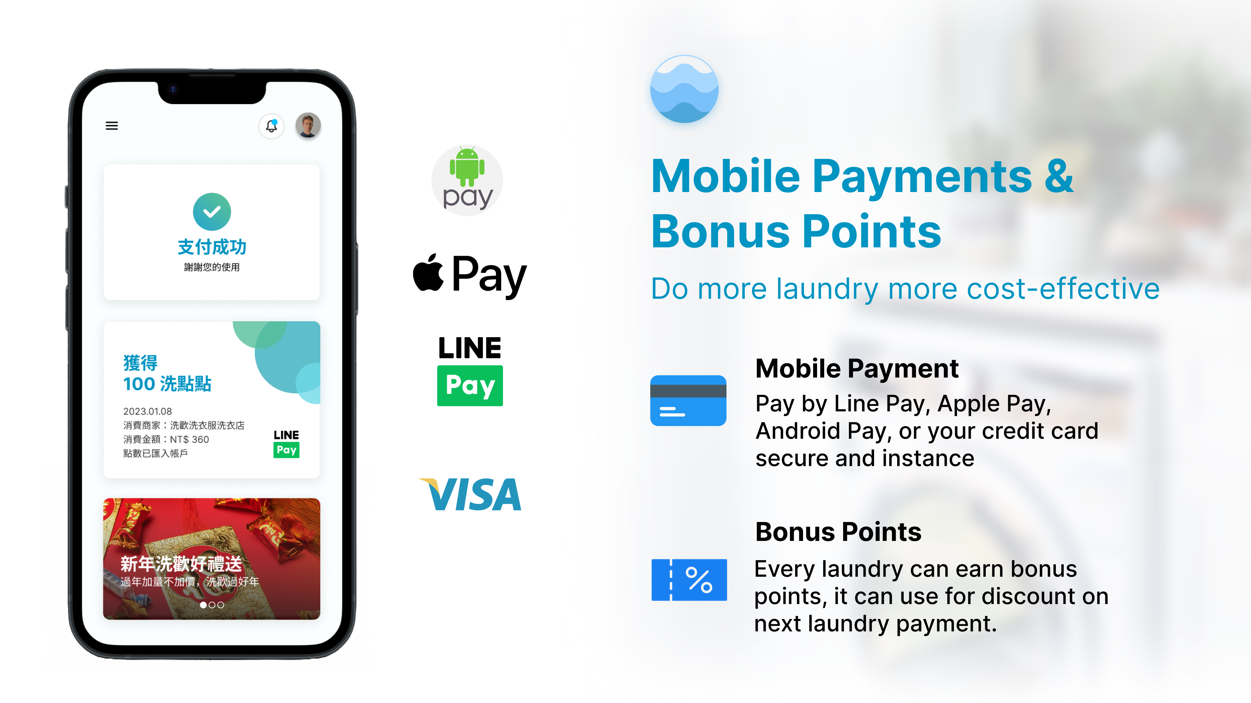
System and structure Software

Slide 22
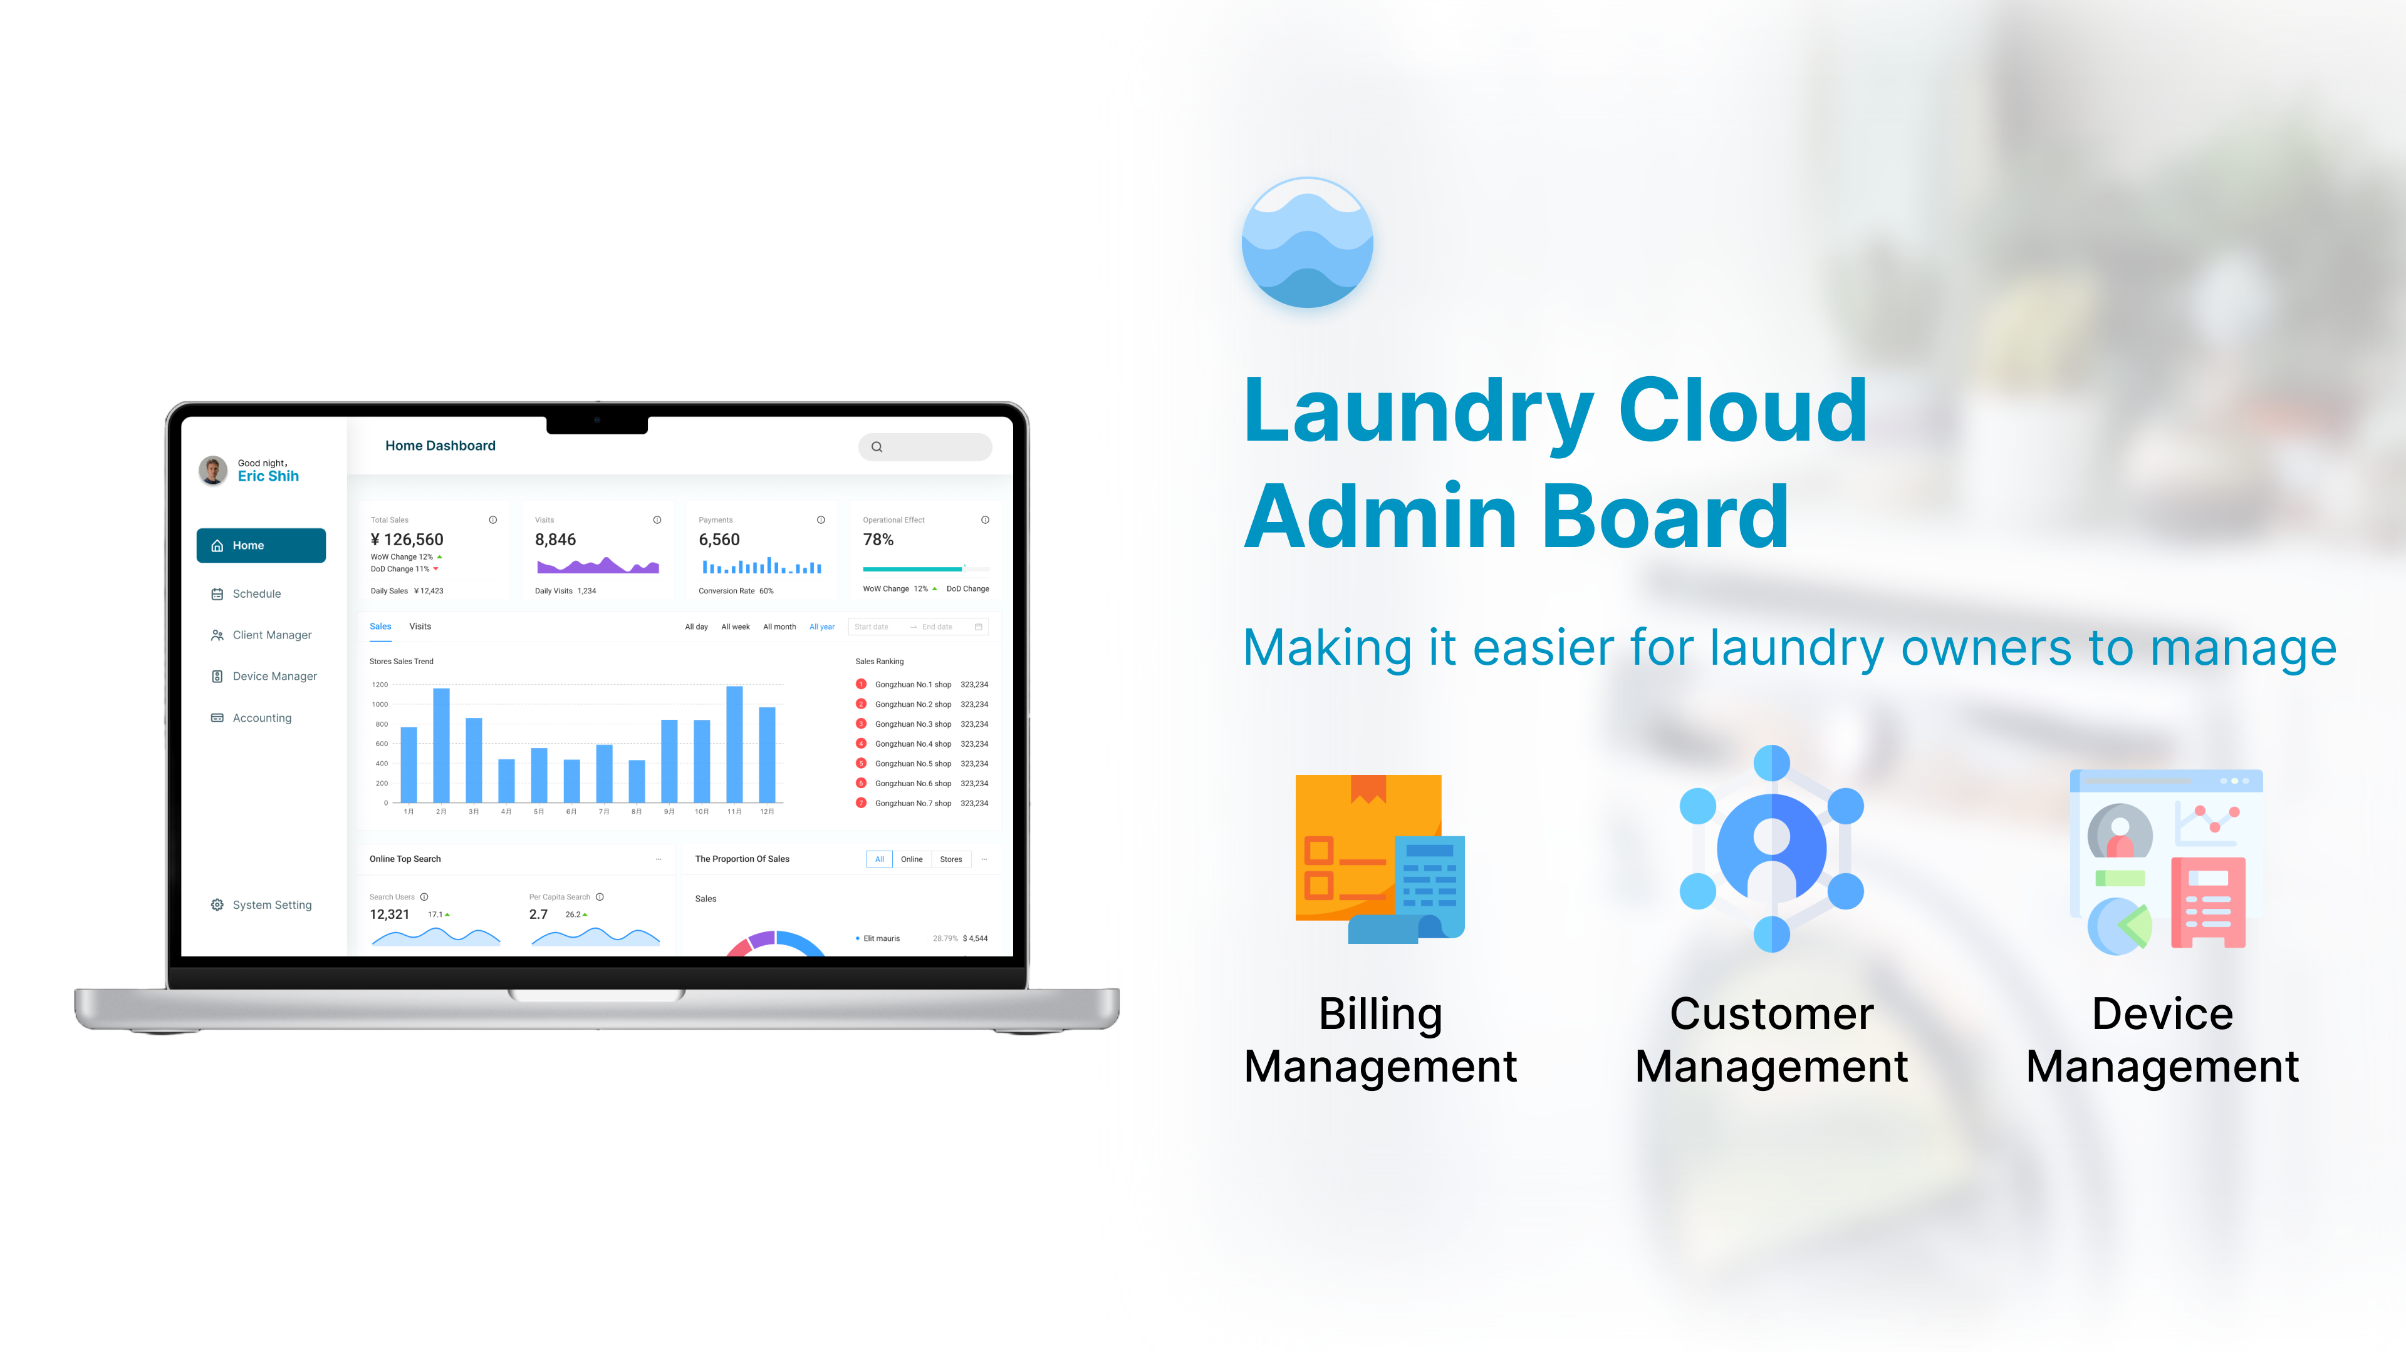
System and structure Laundry Cloud

Slide 23
System and structure Laundry Cloud
Internet Server
Transfer the message from washer, dryer and hanger to client
Electronic Payment
Support the function of the App
Data Server
Client Data Storage
AI Server
Use the data in internet server to tain model
Predict the rush hour of laundry
Consumption of eletricity, gas and water.
Recommendation for the schedule of laundry

Slide 24



Internet
Sever
Internet
Sever
Internet
Internet
Sever
Switch
Switch
Data
Sever
Data
Sever
Data
Sever
Hadoop
AI
Sever
AI
Sever
AI
Sever

Slide 25
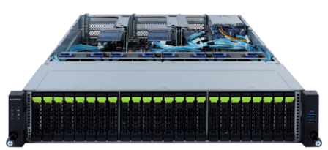
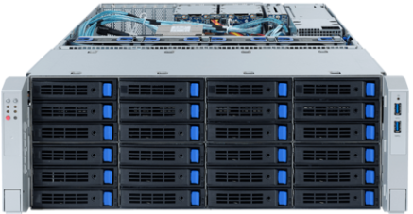
System and structure Laundry Cloud
Internet Server
Gigabyte R282-NO0 Server
2 * Intel Xeon W series, up to 38 core 76 thread per core.
24 x 2.5" Gen4 NVMe hot-swappable SSD bays
Large Data throughput
Use OCP 3.0 high speed network adapter, such as E810-XXVDA2
Or PCIE 3.0 high speed network adapter, such as X710-DA4
Data Server
Gigabyte S452-Z30 Server
Single AMD EPYC™ 7003 series processor family, 64 core 128 thread per core.
36 x 3.5" SATA/SAS hot-swap HDD/ SSD bays
Hadoop system
Large Data storage

Slide 26
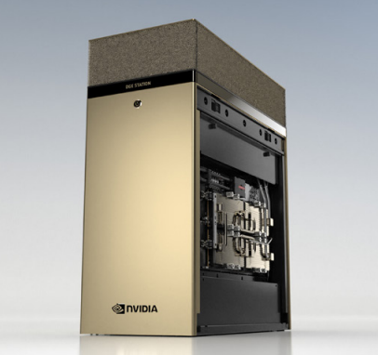
System and structure Laundry Cloud
AI Server
NVIDIA DGX STATION A100
AMD 7742, 64 cores
512 GB Main Memory
4 * NVIDIA A100 80GB GPU
Total 320 GB GPU Memory
2.5 peta Flops AI

Slide 27
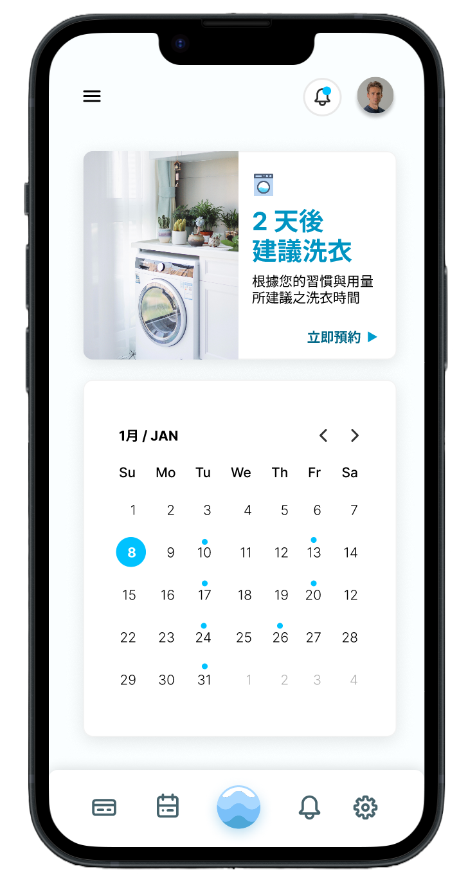

Scenario - reservation
the amount of clothes
user
reserve
Machine status
recommend
reserve machine
Server
weather

Slide 28
Scenario - washing processing
user
Server
Washing/Drying
command
RFID identify
Washing/Drying
complete
notice
Pick up clothes

Slide 29
Outline
Introduction
Motivation and application
System and structure
Software and algorithm
Hardware
Application Scenario
Market analysis
Reference
Task partition

Slide 30
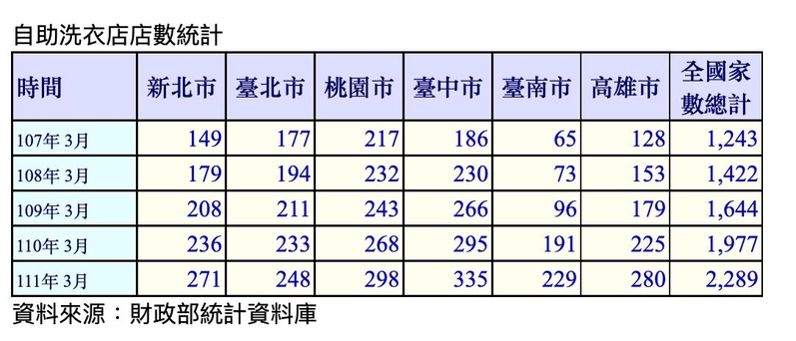
Market analysis
according to statistics from 財政部不動產資訊平台
Since March 2018, there were 1243 laundromats in Taiwan, and by March 2022, there were 2289 laundromats, an increase of 80% over four years.
In 2020, in Taiwan, the value of laundry industry is about TWD 20 billion
Including washing machines, commercial washing machines, self-service laundromats, and traditional laundries
Among these, the total value of self-service laundromats is about TWD 10 billion

Slide 31



Market analysis: TA
Laundry Shop
Home User
School Dormitory

Slide 32
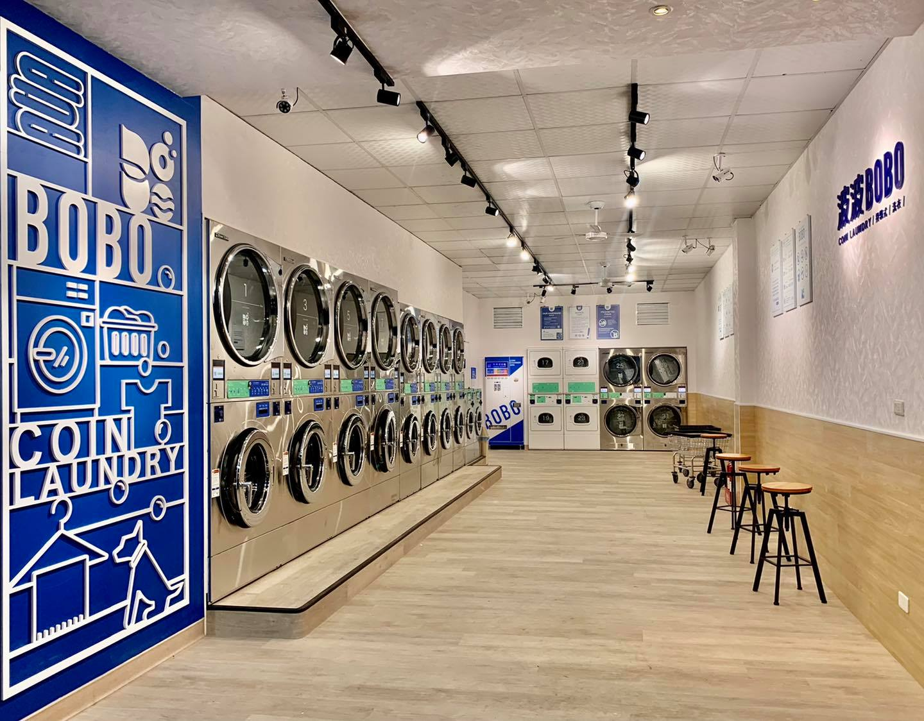
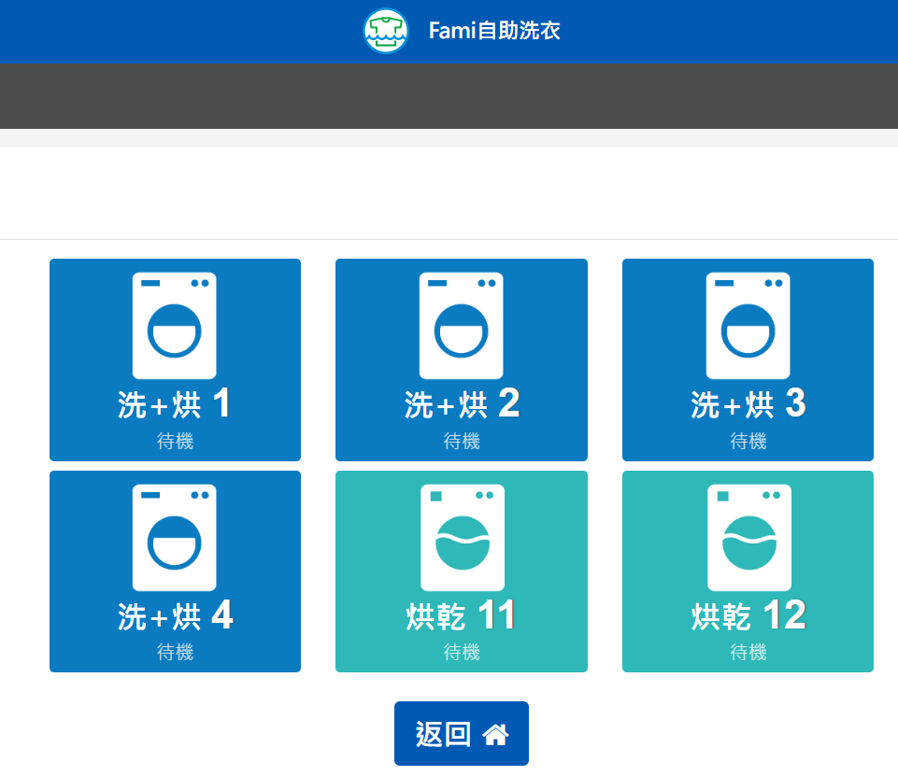

Market analysis: Competitor
Self-service laundry
Fami 自助洗衣 (Family mart)
IoT home washing machine
(panasonic)

Slide 33



Market analysis
 | laundry reminder | Automatically washing (based on each cloth RFID) | Laundry warning | notification (the clothes are sun-dried) | recommend laundry schedule (based on wether) | recommend laundry schedule (based on traffic) | Reserve system
Self-service laundry
IoT home washing machine (panasonic)
fami自助洗衣
Smart Laundry (our)

Slide 34
Outline
Introduction
Motivation and application
System and structure
Software and algorithm
Hardware
Application Scenario
Market analysis
Reference
Task partition

Slide 35
Reference
https://hadoop.apache.org
https://www.gigabyte.com/tw/Enterprise/Rack-Server/R282-NO0-rev-100
https://www.gigabyte.com/tw/Enterprise/Storage-Server/S452-Z30-rev-A00
https://www.nvidia.com/content/dam/en-zz/zh_tw/Solutions/Data-Center/dgx-a100/NVIDIA-DGX-Station-A100-Datasheet_2020-Nov.pdf
https://www.ipro.tw/rfid/rfid-tags/ht-rfid-tags/1431-rw700.html
https://www.dafrfidtagsfactory.com/high-temperature-waterproof-fabric-textile-washable-monza-r6-uhf-rfid-laundry-tag_p94.html

Slide 36
Reference
https://reurl.cc/MXQXN3
https://www.alldatasheet.com/view.jsp?Searchword=Pic12f675&gclid=CjwKCAiA8OmdBhAgEiwAShr406F1YJ-RJtKPovS709Y8J2pun6hOg49yWC_z5j06KapDv4AHSJU4ChoCWLYQAvD_BwE
https://www.taiwaniot.com.tw/product/grove-sunlight-sensor-%E9%99%BD%E5%85%89%E6%84%9F%E6%
https://www.digikey.tw/en/products/detail/sensirion-ag/SHTC3-TR-2-5KS/8628148 B8%AC%E5%99%A8/
https://www.st.com/en/ecosystems/x-nucleo-nfc03a1.html
https://docs.arduino.cc/hardware/uno-rev3
https://www.raspberrypi.com/products/raspberry-pi-3-model-b-plus/

Slide 37
Outline
Introduction
Motivation and application
System and structure
Software and algorithm
Hardware
Application Scenario
Market analysis
Reference
Task partition

Slide 38
Task Partition
Introduction
Motivation and application: 施冠彰
System and structure
Software: 施冠彰
Server: 張又仁
Hardware: 黃廉傑、許詠晴
Application Scenario: all
Market analysis: all
Organize report: all
Presentation: all

